Slide 1
Impedance Matching
PSSE and PSCAD
Nathan Park
12/11/2020

Slide 2
Background
PSSE and PSCAD use different styles to assign impedances in cable and Transformer
Matching impedance has been studied
Based on given PSCAD loadflow model, how to assign impedance will be articulated
PSSE normally follows system MVA that is 100MVA. It can be checked in raw file.
Impedance interpreting and converting is very important to match loadflow file.
In this study
PSCAD base on 123.42
PSSE base on (system base 100MVA but Tx based on winding MVA)

Slide 3
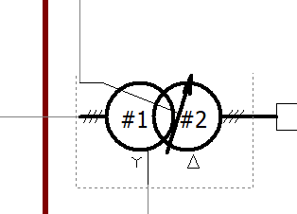
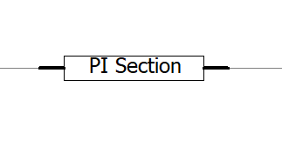
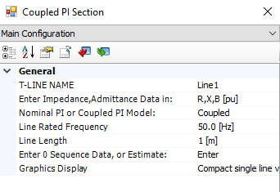
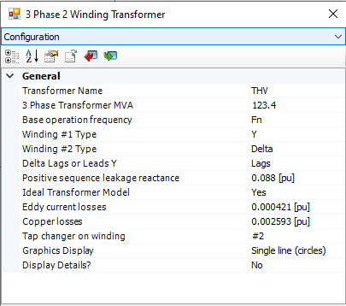
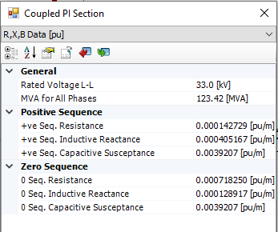
PSCAD

Slide 4
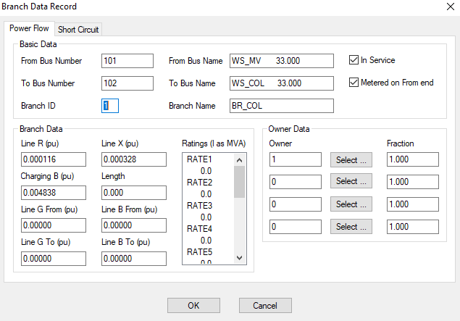
Cable matching
PSSE following System MVA: 100MVA
x 100/123.42
x 100/123.42
x 1 / (100/123.42)
= x 123.42 /100

Slide 5
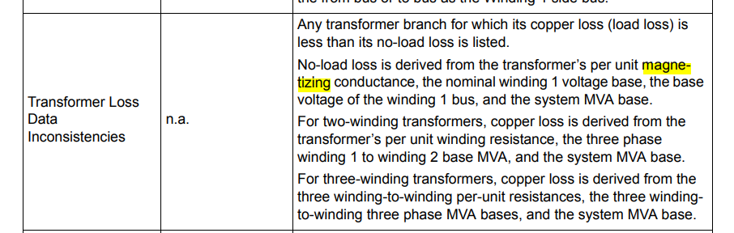
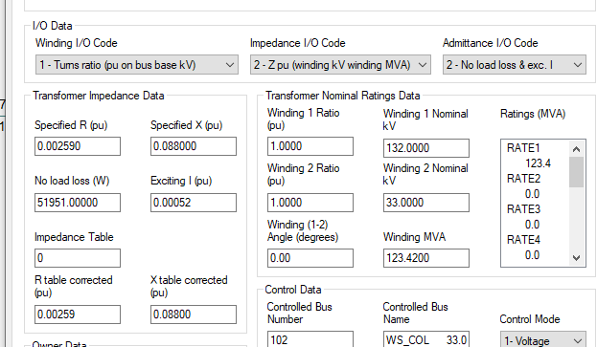
Transformer
Tx sizing base subject to Impedance I/O codes
System MVA Base

Slide 6
Conclusion
Using same base MVA in PSCAD and PSSE e.g. 100MVA. It will be the best way to avoid confusion to match impedance
Should be careful to convert Impedance and Admittance
If PSCAD has 123.42 and PSSE has 100MVA for base,
Impedance should be converted: PSCAD value x (100/123.42) = PSSE value
But Admittance: PSCAD value x 1/(100/123/42) = PSSE value

